Slide 1
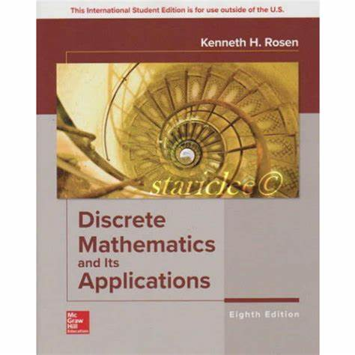

Proposition logic, propositional variable & compound propositional
By Mohammed Ahsan Meah

Slide 2


Slide 3
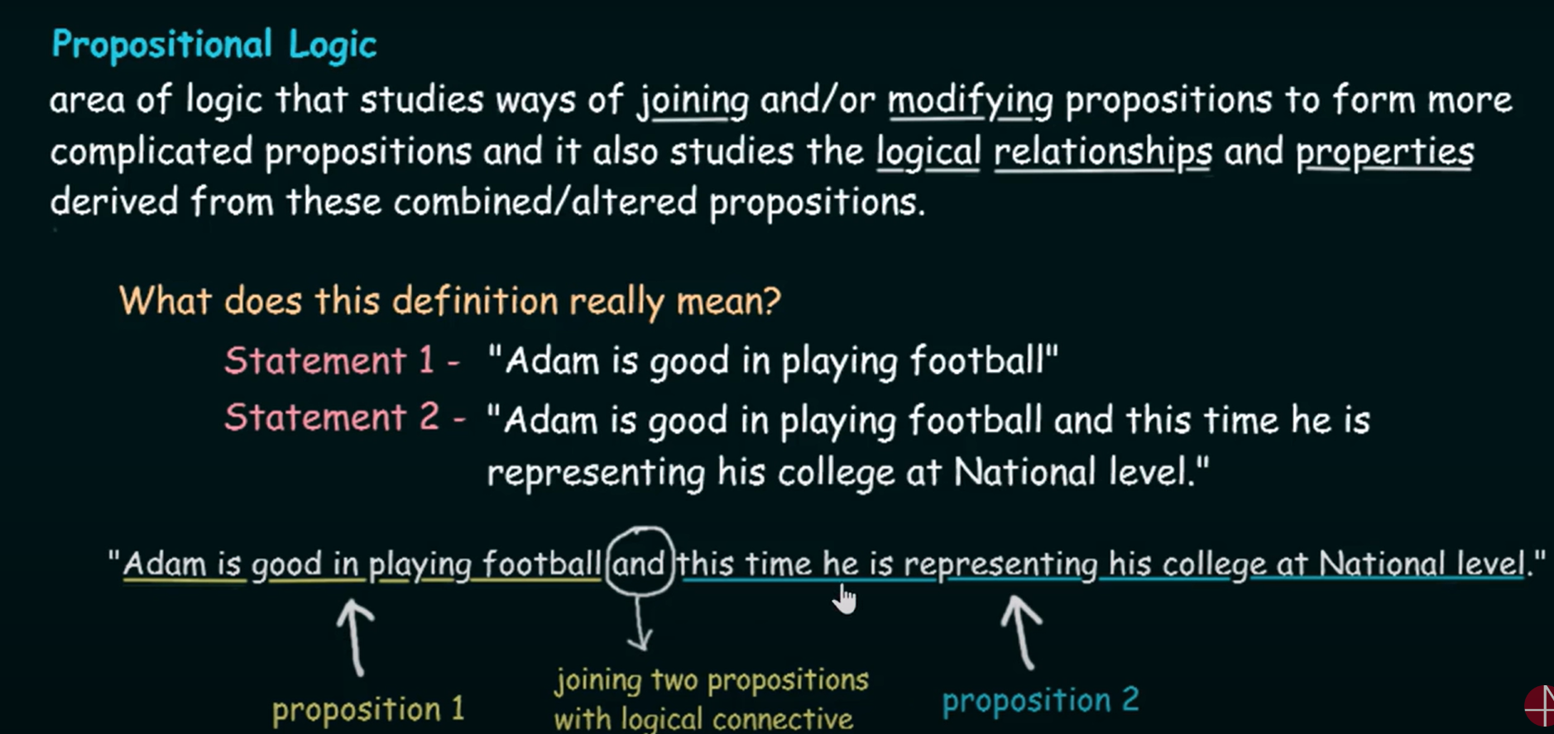

Slide 4


Slide 5



Slide 6


Slide 7
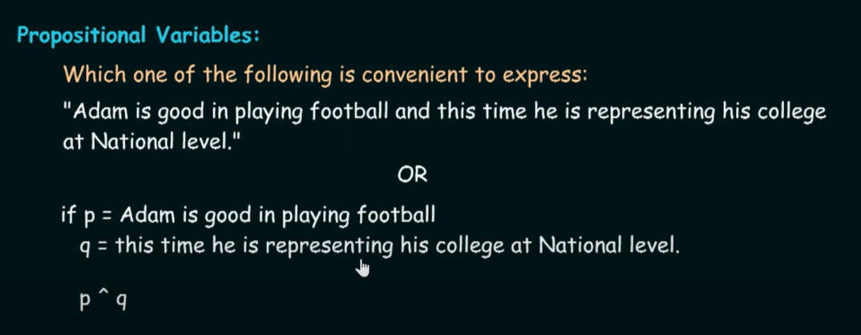

Slide 8
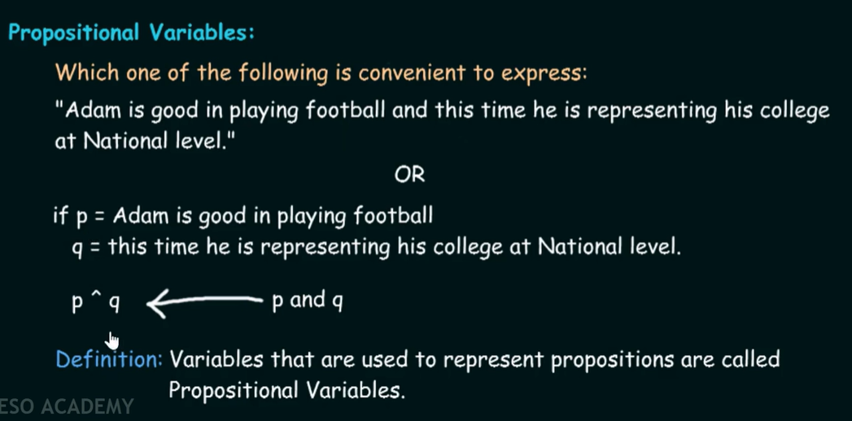

Slide 9


